Slide 1
Bird Species Observation Analysis & Conservation Insights
Insights and Observations in Detail
Joel Ignetious k

Slide 2
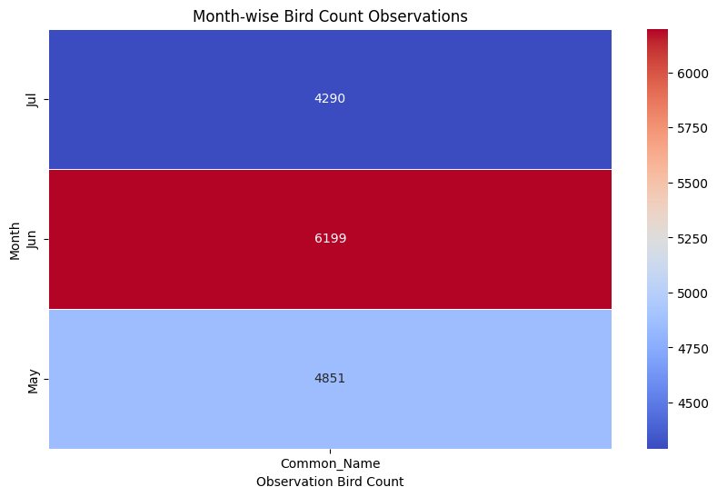
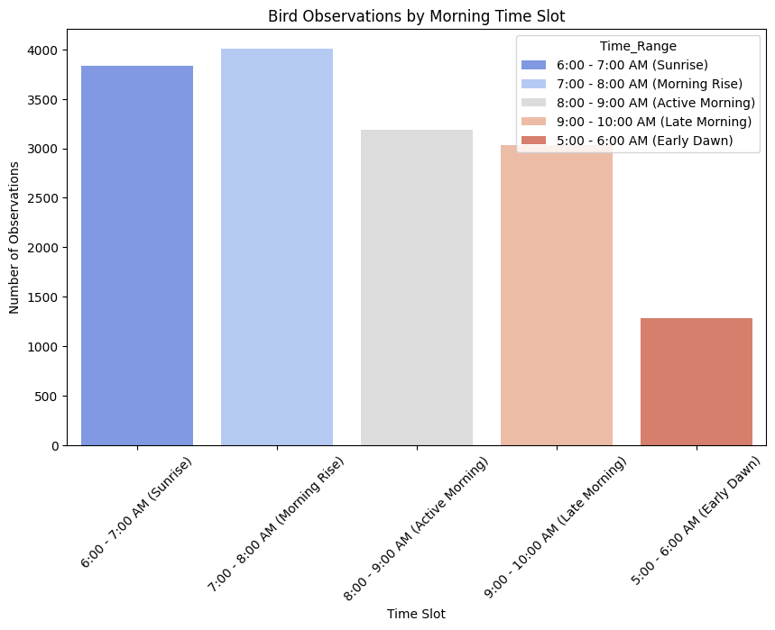
Temporal Analysis
Analyzing Seasonal Trends
The chart displays monthly variations in bird observations, highlighting fluctuations in population counts. June recorded the highest bird count (6,199), followed by May (4,851) and July (4,290). The peak in June suggests increased bird activity, possibly due to migration or breeding. However, the drop in July indicates a shift in environmental conditions or bird movement patterns. Understanding these trends is crucial for conservation efforts and habitat protection.
Analyzing Peak Activity Periods
The chart shows bird activity across different morning time slots, with the highest observations recorded between 7:00 - 8:00 AM (Morning Rise) and 6:00 - 7:00 AM (Sunrise). The number of sightings decreases gradually after 8:00 AM, indicating reduced bird movement as the day progresses. The lowest observations occur in the 5:00 - 6:00 AM (Early Dawn) slot, suggesting limited activity before sunrise. These trends highlight optimal periods for birdwatching and ecological studies.

Slide 3
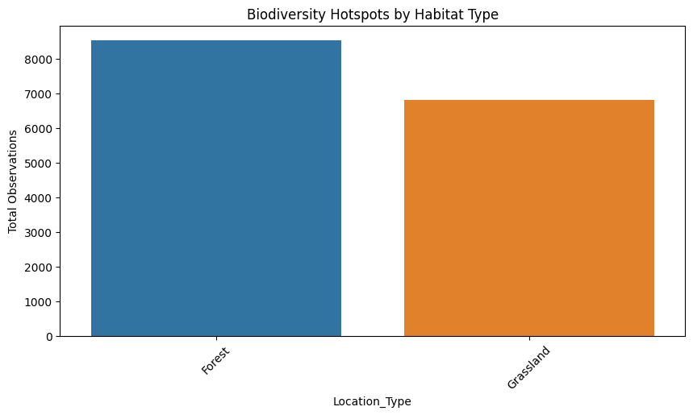
Spatial Analysis
Biodiversity Hotspots by Habitat Type
Forests have higher bird observations than grasslands, indicating greater bird activity and biodiversity. This emphasizes the importance of forest conservation for sustaining bird species.

Slide 4
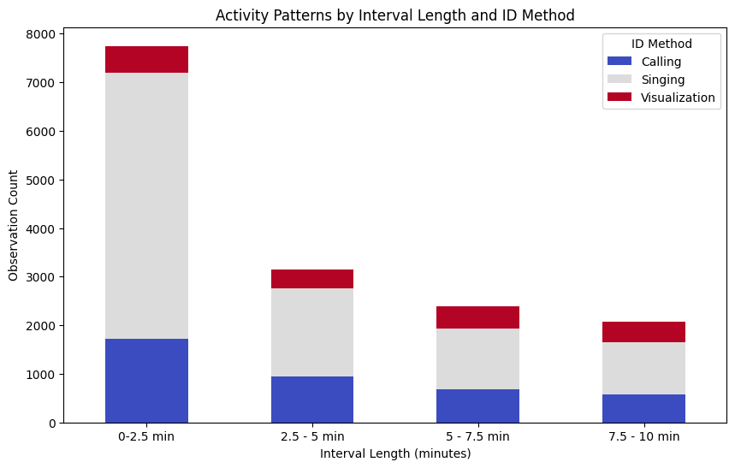
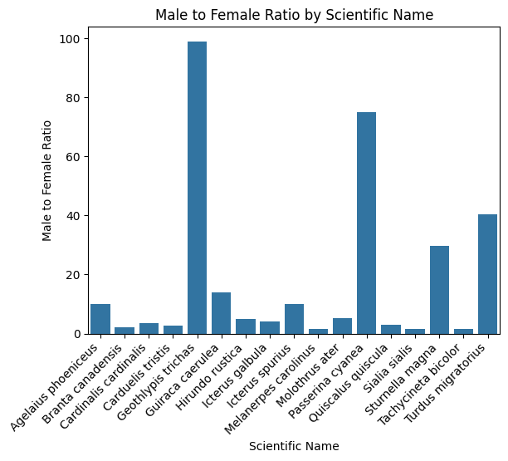
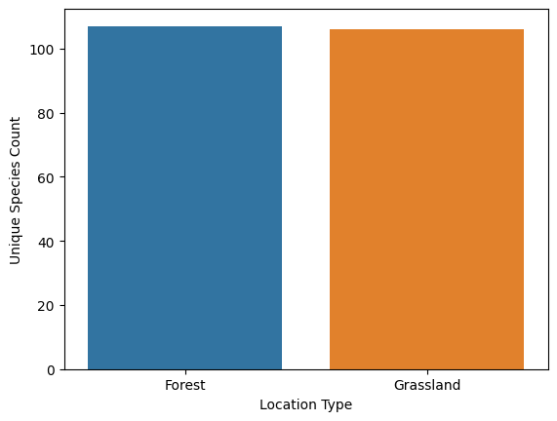
Species Analysis
Unique Species Count by Habitat
Forests and grasslands support a nearly equal number of unique bird species. This indicates that both habitats contribute significantly to biodiversity, emphasizing the need for conservation efforts across different ecosystems.
Activity Patterns by Interval Length
Most bird observations occur within the first 2.5 minutes, predominantly through singing and calling. This suggests that early monitoring captures peak avian activity, making it crucial for effective data collection.
Male-to-Female Ratio
Some species like Hirundo rustica and Quiscalus quiscula show extreme male dominance.
Balanced ratios are observed in species like Cardinalis cardinalis and Turdus migratorius.
Male bias could be due to visibility differences in behavior or plumage.

Slide 5
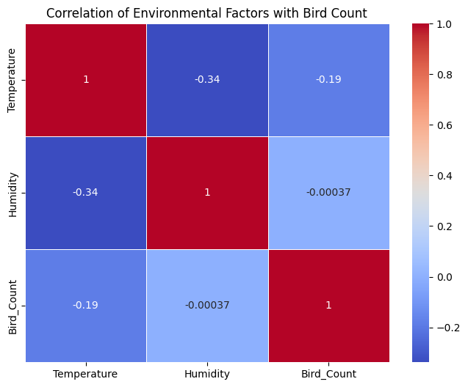
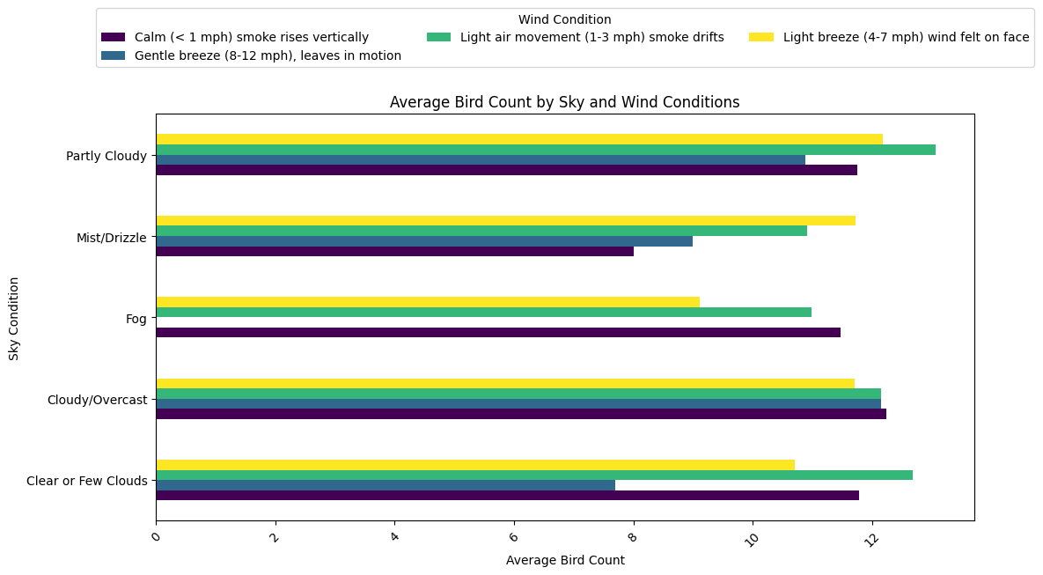
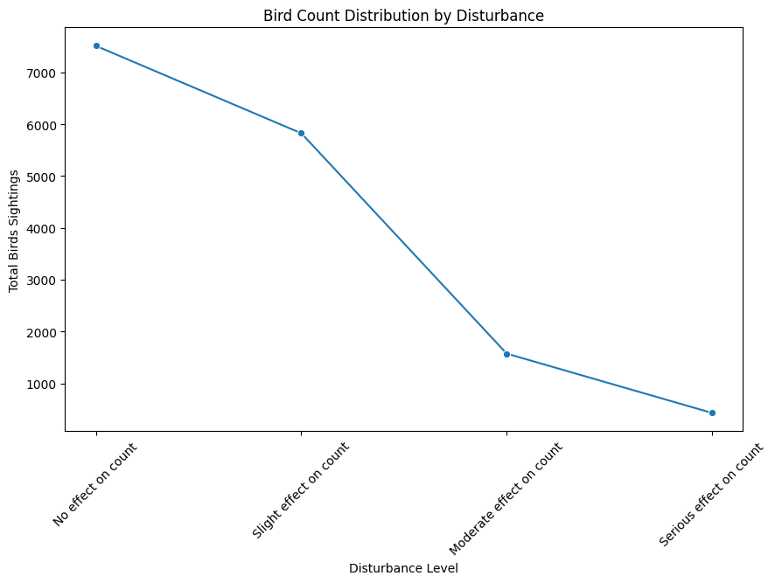
Environmental Conditions
Correlation Analysis
Temperature has a weak negative correlation (-0.19) with bird count, suggesting slight avoidance in warmer conditions.
Humidity shows almost no impact (-0.00037) on bird count, indicating minimal influence.
Temperature and humidity have a moderate negative correlation (-0.34), meaning higher temperatures tend to reduce humidity.
Sky & Wind Conditions affects Bird Count Or not
Higher bird counts are observed in light air movement (1-3 mph) and light breeze (4-7 mph) conditions.
Partly cloudy and clear skies tend to have more bird activity.
Fog and mist reduce bird counts, likely due to low visibility.
Cloudy/overcast conditions show a moderate impact on bird counts.
Impact of Disturbance on Bird Sightings
Bird sightings decline as disturbance levels increase. The highest counts are observed in undisturbed areas, while moderate and serious disturbances lead to a significant drop in bird observations.

Slide 6
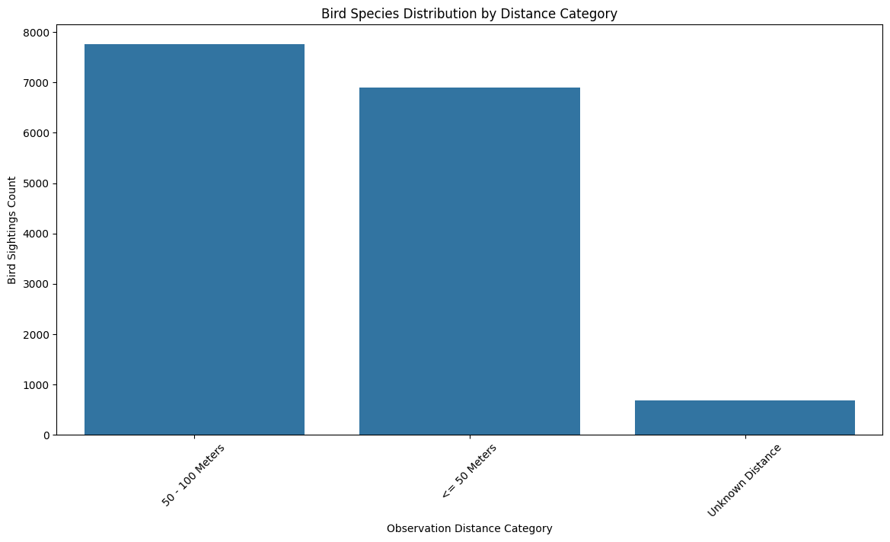
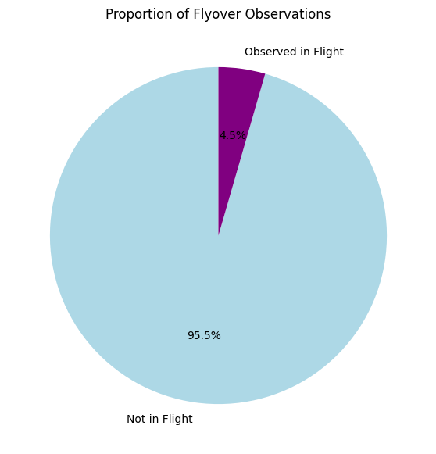
Distance And Behavior
Bird Sightings by Observation Distance
Most bird sightings were recorded within the 50–100 meters range, slightly higher than the ≤ 50 meters category. The unknown distance category had very few sightings, possibly due to missing data or observer limitations.
Flyover Observations Proportion
The majority of bird observations (95.5%) were recorded while birds were not in flight, with only 4.5% observed flying. This suggests that most data collection occurred when birds were stationary or at rest.

Slide 7
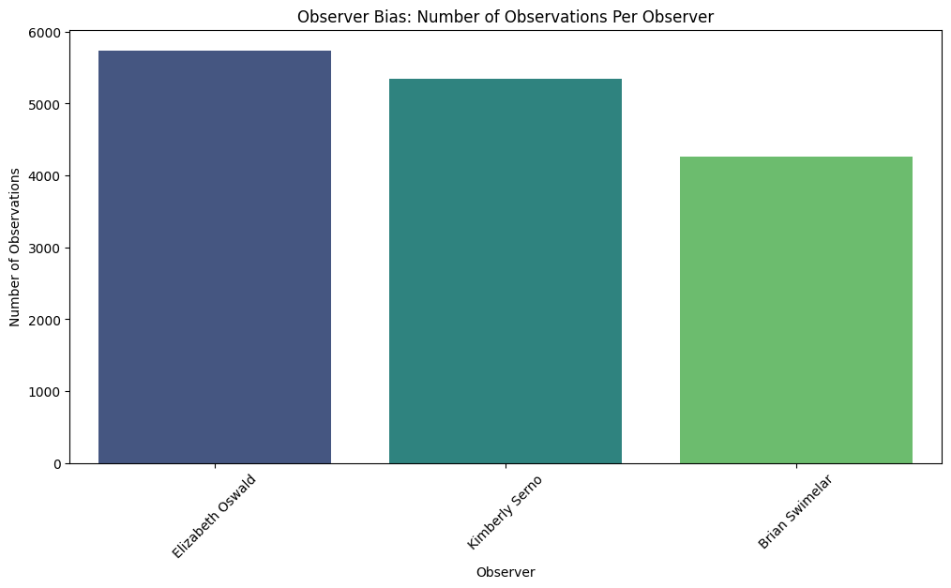
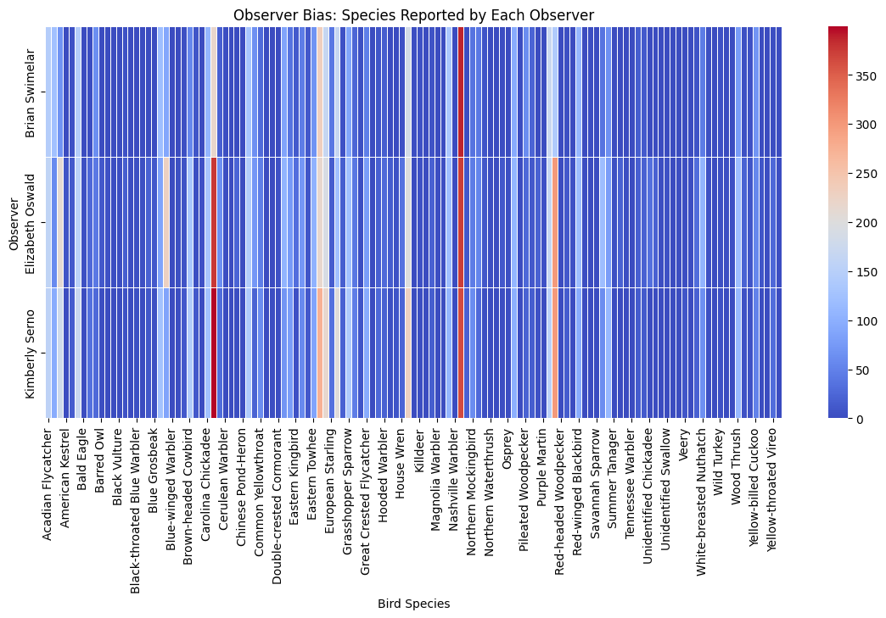
Observer Trends
Observer Bias in Species Reporting
This heatmap illustrates how different observers report bird species. Variations in color intensity indicate differences in species observations, with some species being more frequently recorded by certain observers. This suggests potential observer bias, where experience, location, or personal focus may influence species identification and reporting.
Observer Bias in Bird Observations
The Below chart shows variations in observation counts among observers. Elizabeth Oswald recorded the highest number of observations, followed by Kimberly Serno, while Brian Swimalar contributed the least. This indicates possible observer bias, where individual effort, skill, or availability may influence the dataset.

Slide 8
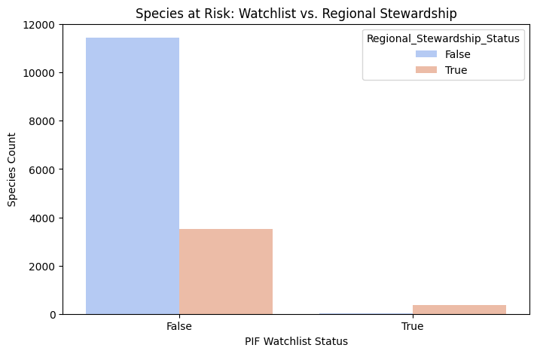
Conservation Insights
The majority of species not on the watchlist are also not under regional stewardship, indicating they are relatively stable.
A smaller proportion of species not on the watchlist are marked for regional stewardship, suggesting localized conservation efforts.
Very few species appear on the PIF Watchlist, but those that do are mostly under regional stewardship, reflecting targeted conservation priorities.
This chart shows that most species are not at risk, but some under regional stewardship need conservation. Few species are on the PIF Watchlist, highlighting targeted protection efforts.

Slide 9
Thank You
Dashboard Insights are given there itself

